Slide 1
Problem Statement - Part II

Slide 2
Question 1
What is the optimal value of alpha for ridge and lasso regression? What will be the changes in the model if you choose double the value of alpha for both ridge and lasso? What will be the most important predictor variables after the change is implemented?

Slide 3
Answer
Optimal value of alpha :-
Best Alpha value for Lasso : 0.001
Best Alpha value for Ridge : 0.9
After comparing both the model we can see that the below Features are best explaining the Dataset
1)MiscVal : $Value of miscellaneous feature
2)BsmtHalfBath : Basement half bathrooms
3)LowQualFinSF : Low quality finished square feet (all floors)
4)BsmtFullBath : Basement full bathrooms
5)HalfBath : Half baths above grade

Slide 4
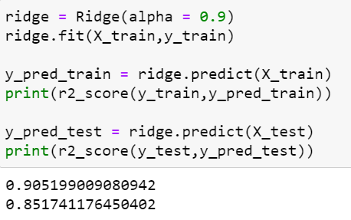
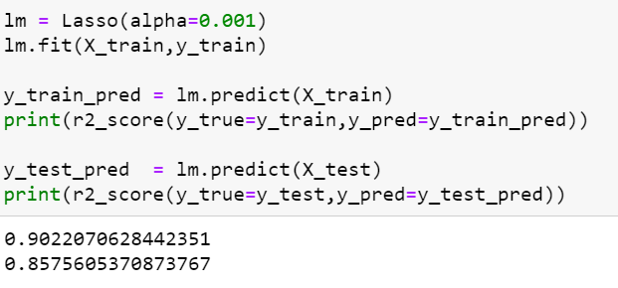
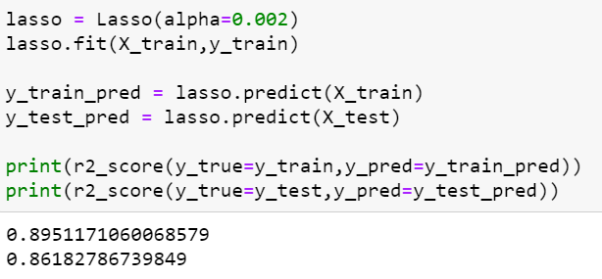
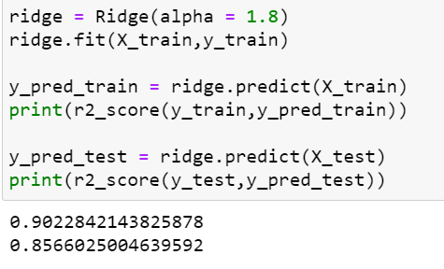
Changes in the model if you choose double the value of alpha for both ridge and lasso:- As lambda value increases further, we notice that the model starts underfitting. This can be seen by the decrease in R-squared value decreases for the train data and increases for test data
Ridge Regression: Before & After
Lasso Regression: Before & After

Slide 5
Question 2
You have determined the optimal value of lambda for ridge and lasso regression during the assignment. Now, which one will you choose to apply and why?

Slide 6
Answer
Even though the R Squared_scores are almost same for both Lasso & Ridge Regression, Lasso Regression Model is selected:-
Lasso will penalize more on the dataset
Help in feature elemination Lasso Regression Model is selected

Slide 7
Question 3
After building the model, you realized that the five most important predictor variables in the lasso model are not available in the incoming data. You will now have to create another model excluding the five most important predictor variables. Which are the five most important predictor variables now?

Slide 8
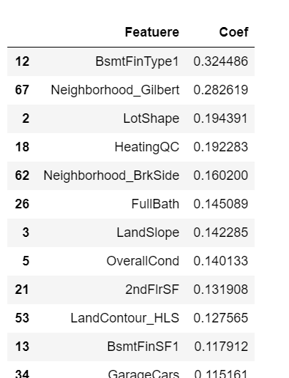
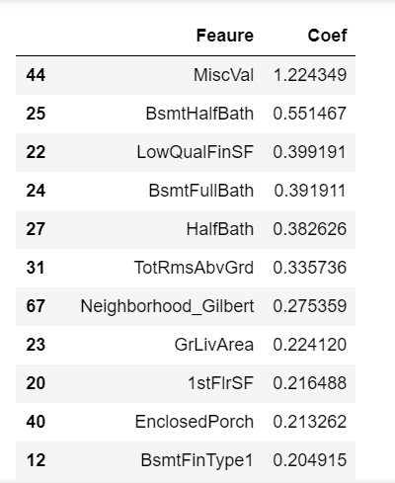
Answer
BsmtFinType1:Rating of basement finished area
Neighborhood_Gilbert: Physical locations within Ames city limit()
LotShape : General shape of property
HeatingQC : Heating quality and condition
LandContour_HLSe : Flatness of the property
Lasso Regression Model
Ridge Regression Model
Five most important predictor variables in the lasso model are not available in the incoming data. After removing those-

Slide 9
Question 4
How can you make sure that a model is robust and generalisable? What are the implications of the same for the accuracy of the model and why?

Slide 10
Answer
1)The model should be able to indentify the underlying patterns of the data
other than the one which were used during training.
2) The model should also be generalisable so that the test accuracy is not lesser than the training score
3) In order that the accuracy predicted by the model is high, too much weightage should not given to the outliers. The outlier analysis needs to be done and only those which are relevant to the dataset need to be retained.
4)Confidence intervals can be used
The accuracy is the same due to the fact that neither of the models are able to distinguish between the classes(in case of classification problem) &
Or the optimizer is not suited to your dataset. We need to look at K-Fold Validation for this

